Slide 1

Green party Mumbai,India
Team Members
Kandarp Khandwala
Zorawar Sachdev
Priyanka Sabhagani
Aanchal Dadlani
Partners or NGOS worked with
CERE India

Slide 2
Problem:
Increasing the public awareness and making people to contribute to society by any means.
Solve problems pertaining to a local area.
Notes:
2

Slide 3
Solution:
Promoting events
Raising awareness
Prompting action
Helping Society
Notes:
3

Slide 4
Having social media presence is one thing, but having social media success is another. It is about engaging, really taking into account what people are saying, listening, making changes.
Notes:
4

Slide 5
Features:
Sharing: To spread the awareness of a particular issue, people can share this on social websites like facebook.
Member profile: Each activist maintains a personal page,home to number of causes he participated in,donations made,and a Green-o-Meter.
Location based: Causes pertaining to the user location, as well as events by location.
Different types of members:Charity,Activists,NGOs
Realtime Event Notifications: GCM Based Push Notifications
Notes:
5

Slide 6
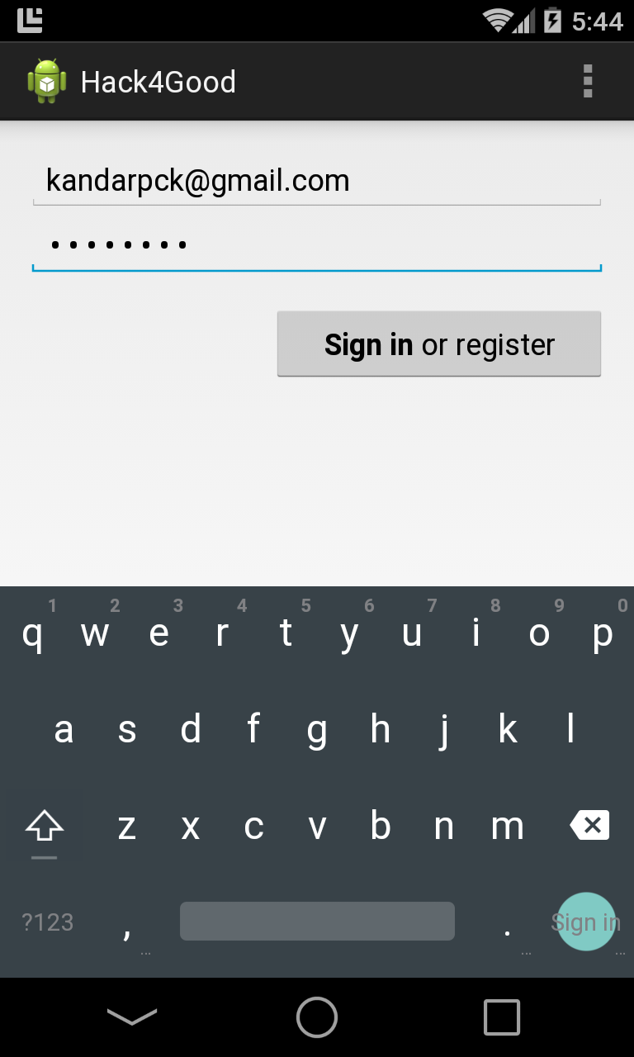
App Screens
The Login Page
Push Messaging

Slide 7
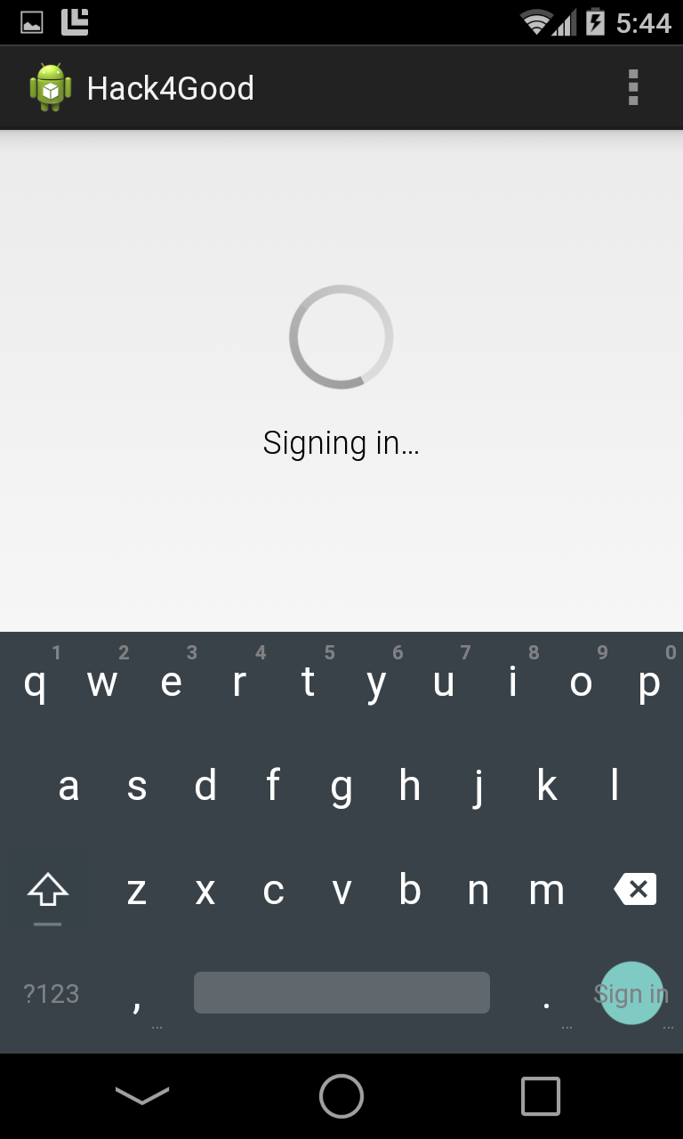
Sign in as
Activist,
NGO or
Charity

Slide 8
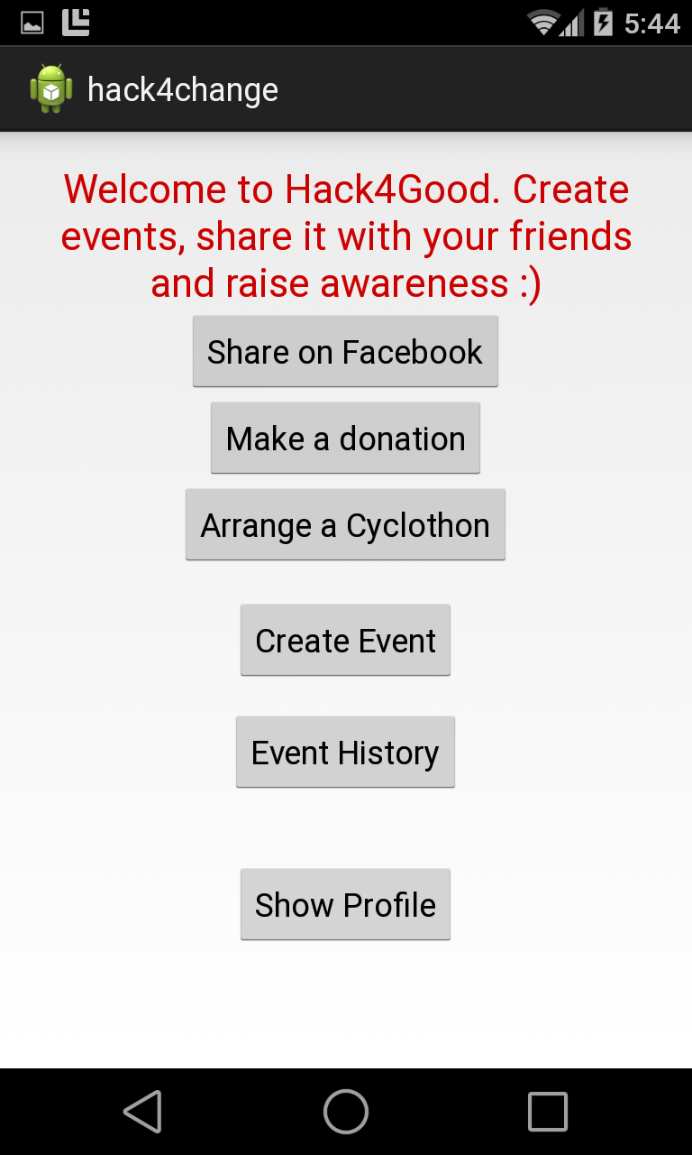
Welcome Screen

Slide 9
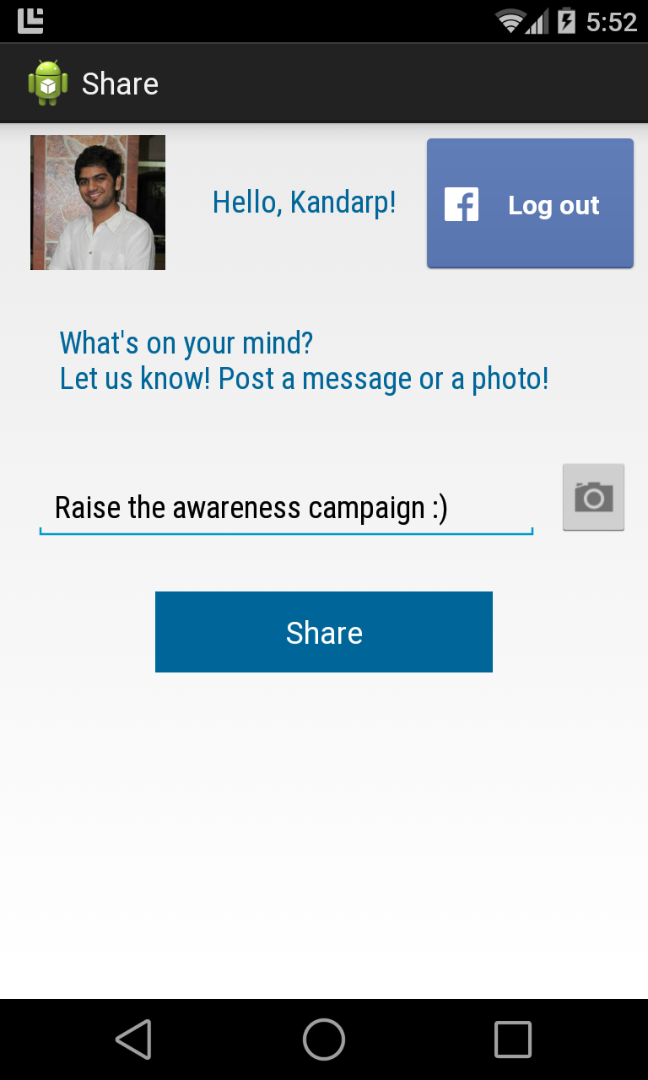
Digital Activism: Share your event
on Facebook

Slide 10
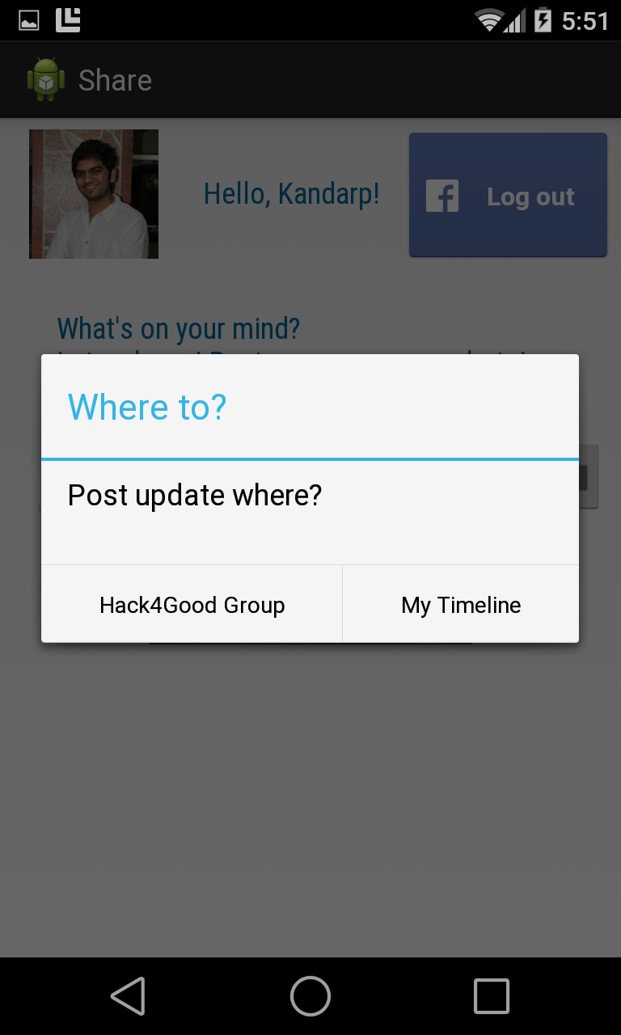
Choose your
Groups

Slide 11
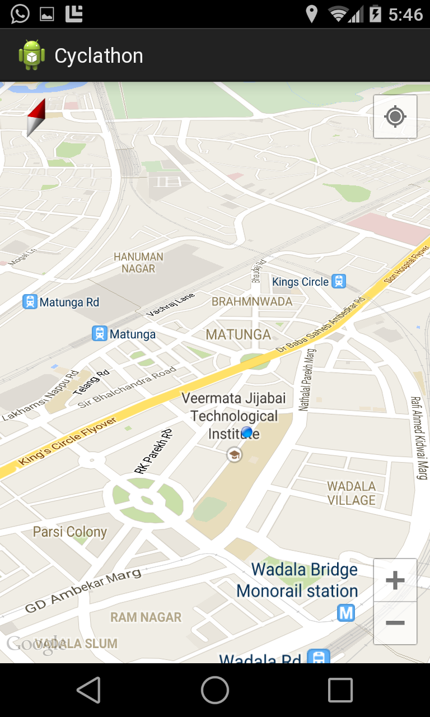
Arrange a
Cyclothon

Slide 12
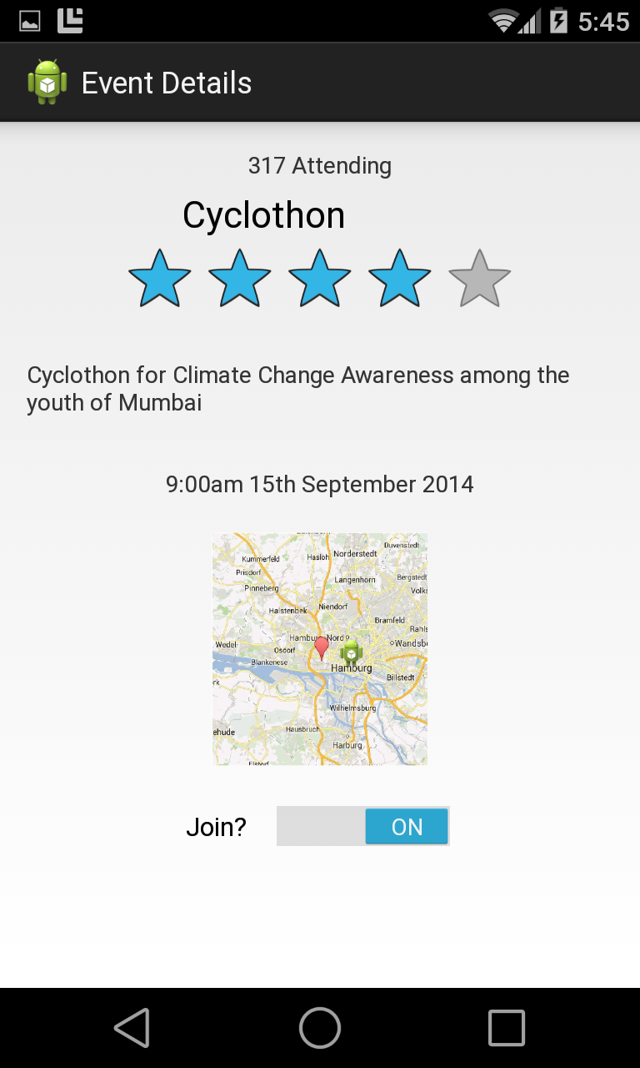
Browse different
Events nearby

Slide 13
Q&A
Notes:
13

